Slide 1

Mars open project’22
ROBOTIC ARM SIMULATION
AJAY Kr. SONWANI
HARSH KUMAR
AVIRAL JAIN
SAKSHAM JAISWAL
MENTORS-
HARSHINI MAM
DIWAHAR SIR

Slide 2
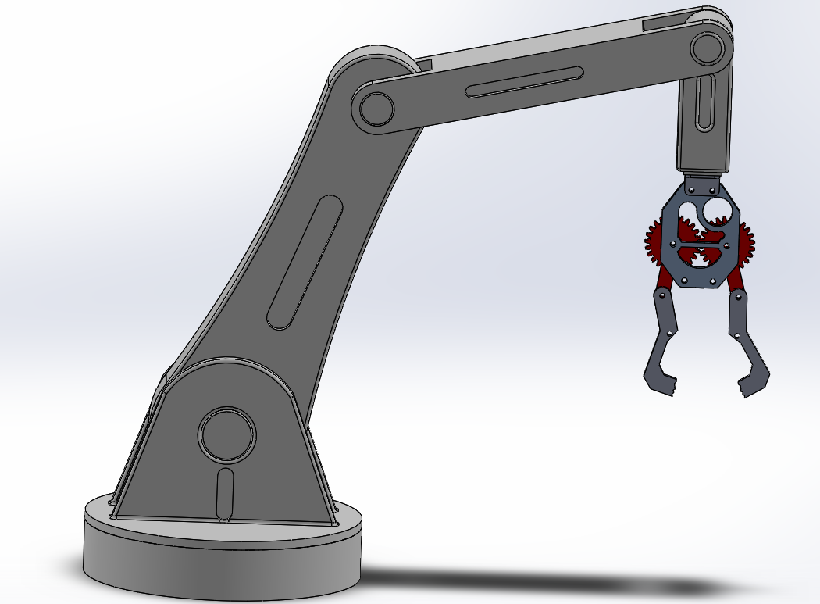
Robotic arm
Designed in- Solidworks
Limbs
Designed by-
Ajay Kr. Sonwani
Saksham Jaiswal
Gripper
Joint
Base

Slide 3
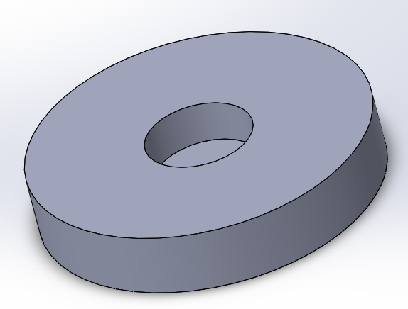
BASE
FEATURES OF SOLIDWORKS USED
Extruded Boss/Base
Extruded Cut
Smart Dimension.
It is the stand of the robotic arm.

Slide 4
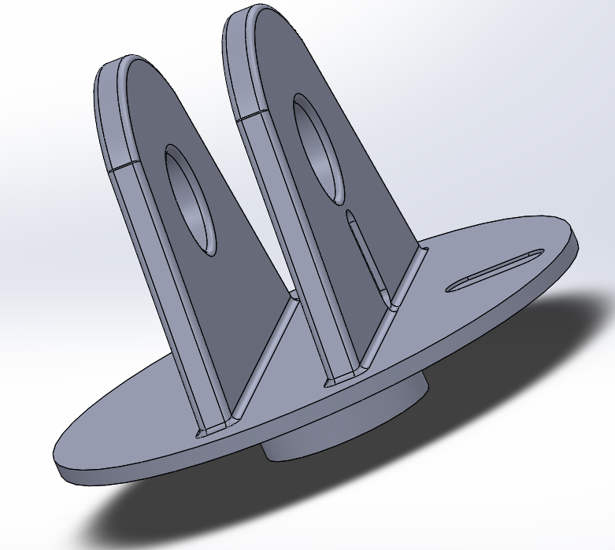
JOINT
FEATURES USED
Extruded Boss/base
Extruded Cut
Mirror
Fillet
Smart Dimension
It is used to join the base and the limb.

Slide 5
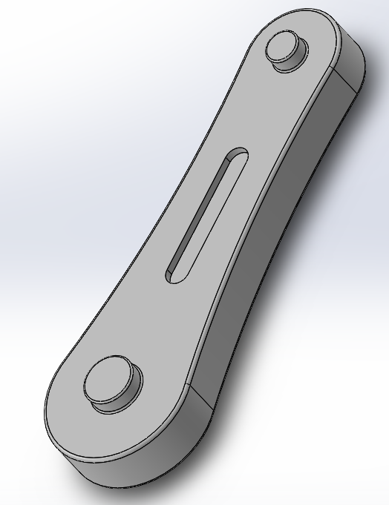
Link-1
FEATURES USED
Extruded Boss/base
Extruded Cut
Mirror
Fillet
Smart Dimension
It is the moving part of the robot.

Slide 6
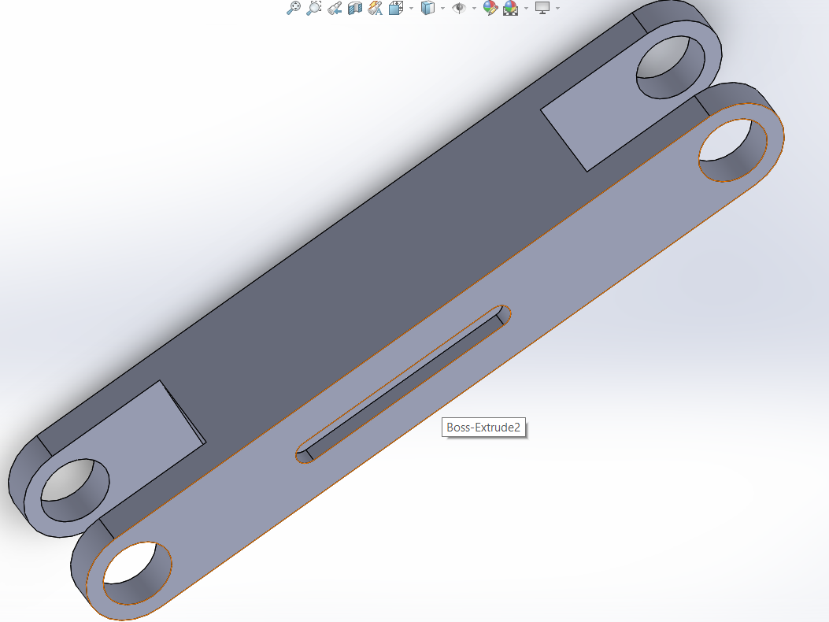
Link-2
FEATURES USED
Extruded Boss/base
Extruded Cut
Mirror
Fillet
Smart Dimension
It is the moving part of the robot.

Slide 7
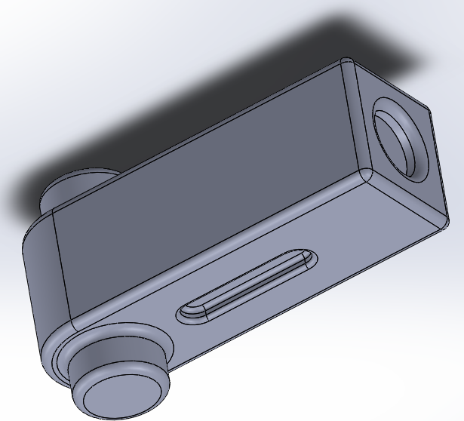
Link-3
FEATURES USED
Extruded Boss/base
Extruded Cut
Mirror
Fillet
Smart Dimension
It is the moving part of the robot.

Slide 8
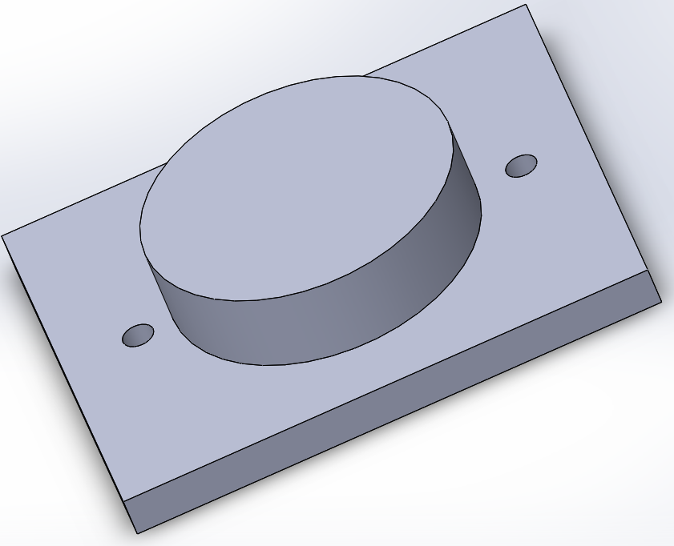
Link-4
FEATURES USED
Extruded Boss/Base
Extruded Cut
Smart Dimension.
It is used to join the gripper with the limbs.

Slide 9
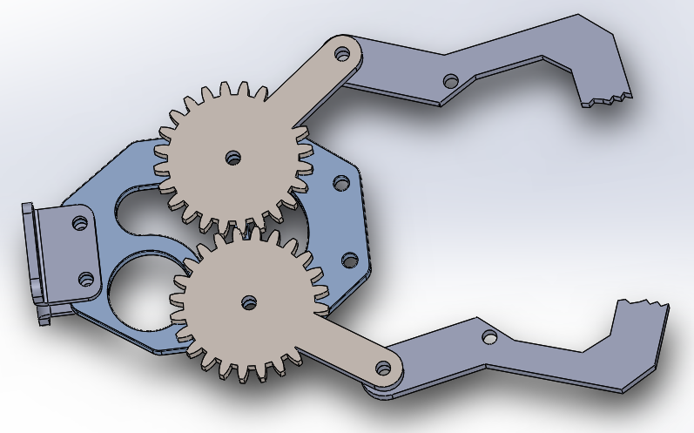
Gripper
Spur Gear
Base
Teeth
Joint

Slide 10
Features used to make gripper
Spur Gear
Extruded Boss/Base
Extruded Cut
Sheet Metal
Base-Flange
Fillet
Smart Dimension

Slide 11
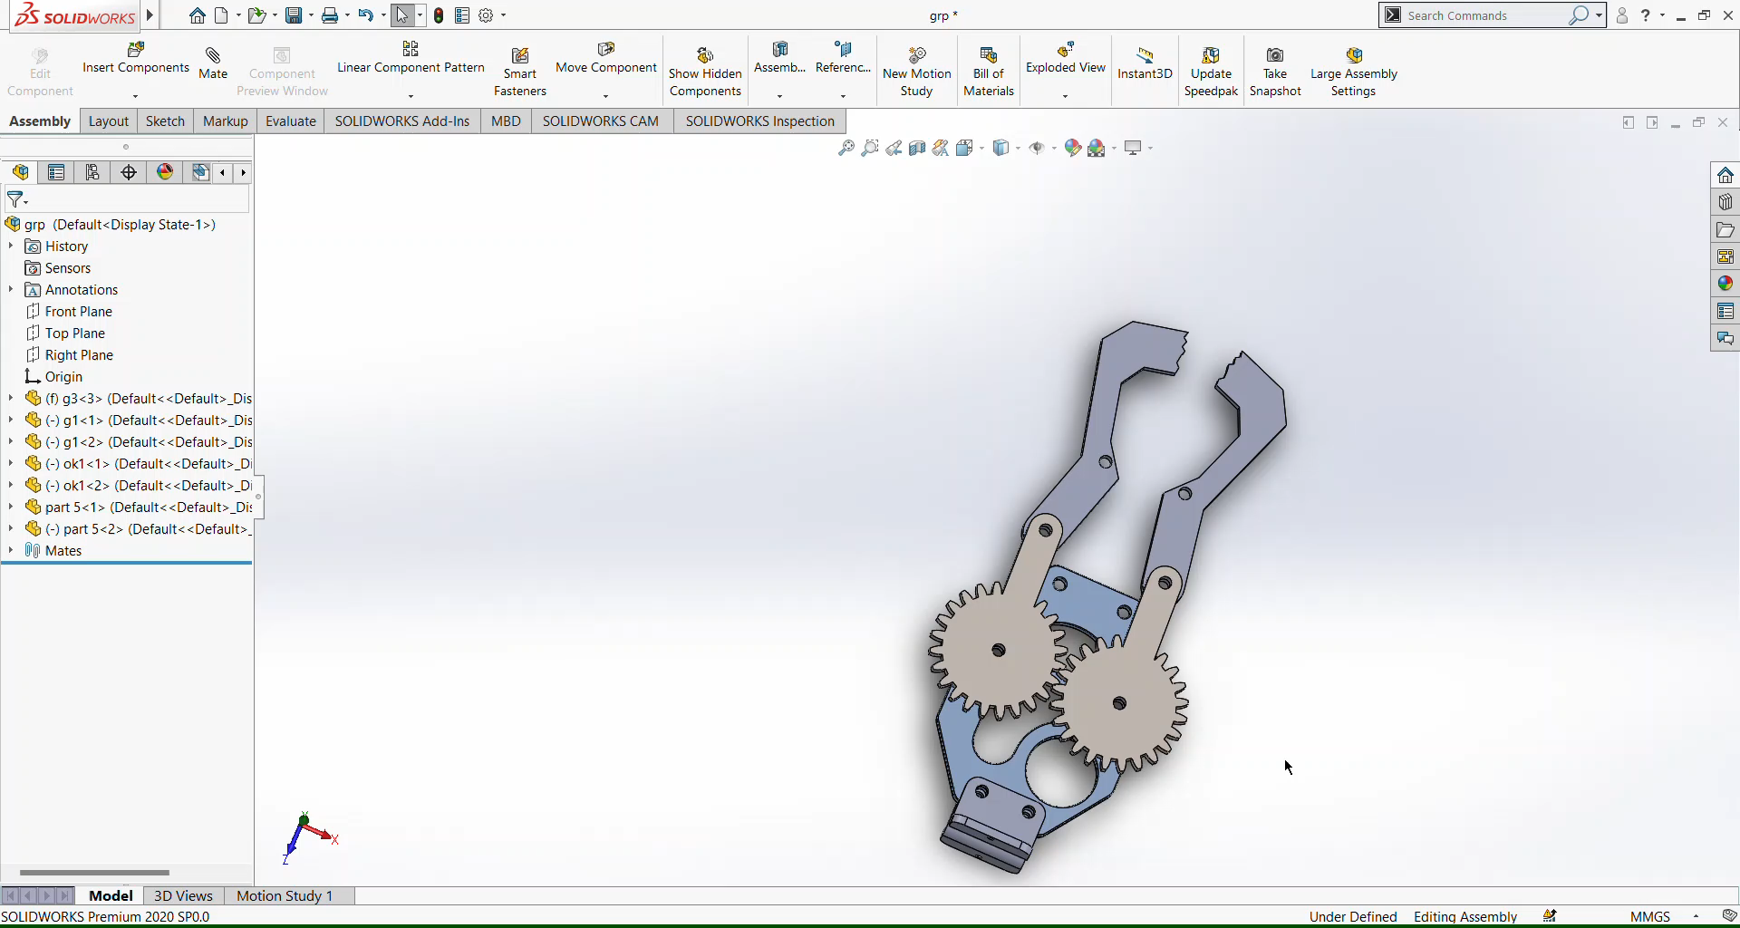
Working of gripper

Slide 12
Solid works file to urdf
Steps-
Create mates to specify the reference position of each link and then suppress them.
Create axis for each joint around which the link will move.
Give name, reference axis , joint type and number of child links.
Click preview and export.
Then give lower and upper limits for the movements of the specific part with respect to its reference axis ,effort and velocity for the movement.
Then make sure that each part is having a positive mass and then export.

Slide 13
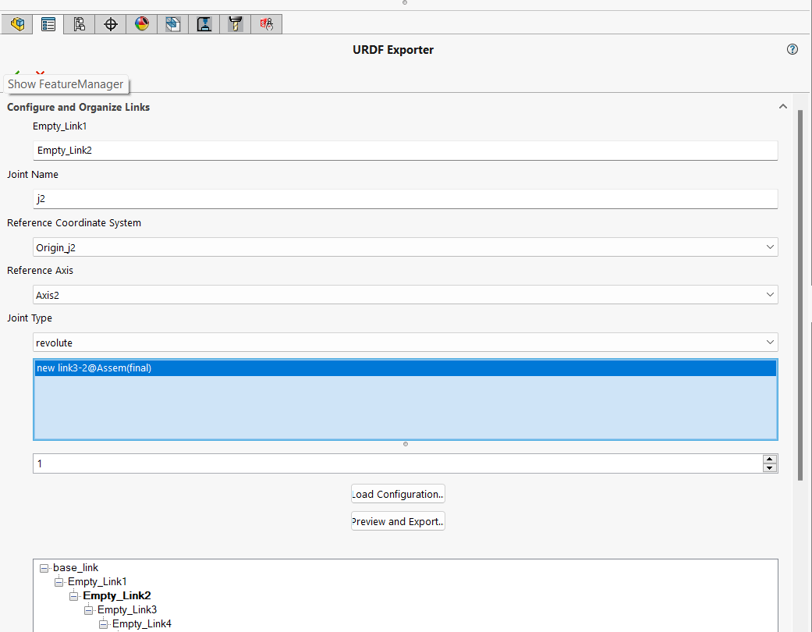

Slide 14
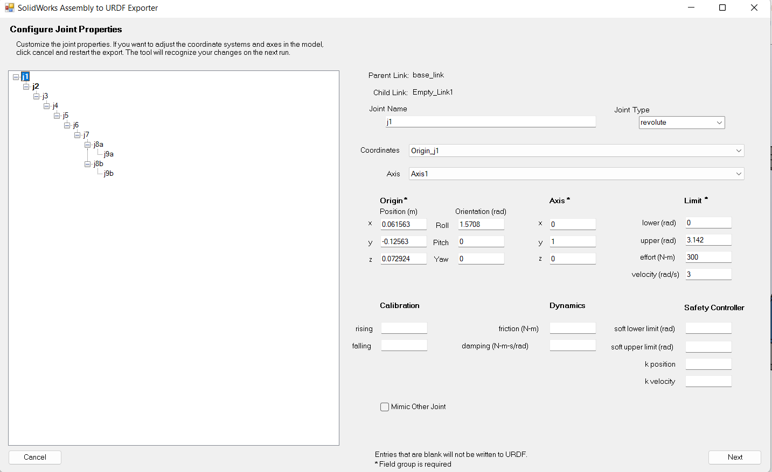

Slide 15
Tags in urdf
Robot tag- A proper XML file should have an XML declaration/prolog in the first line, and then after that will be a single tag (called the root tag), which ALL the other tags live inside of. For a URDF file, this root tag will be the robot tag, and the only thing to note here for now is that we can set the name attribute which lets us (unsurprisingly) specify the name of our robot.
Link tag- A link tag lets us firstly specify the name of a link, as well as some additional characteristics - the visual, collision, and inertial properties. These additional tags are generally optional, however they will be required for certain situations such as simulations (which we’ll cover in a later tutorial).
Joint tag- the joints are actually where all the detail is in terms of the robot’s structure, as they define the link locations, and how they move relative to each other

Slide 16
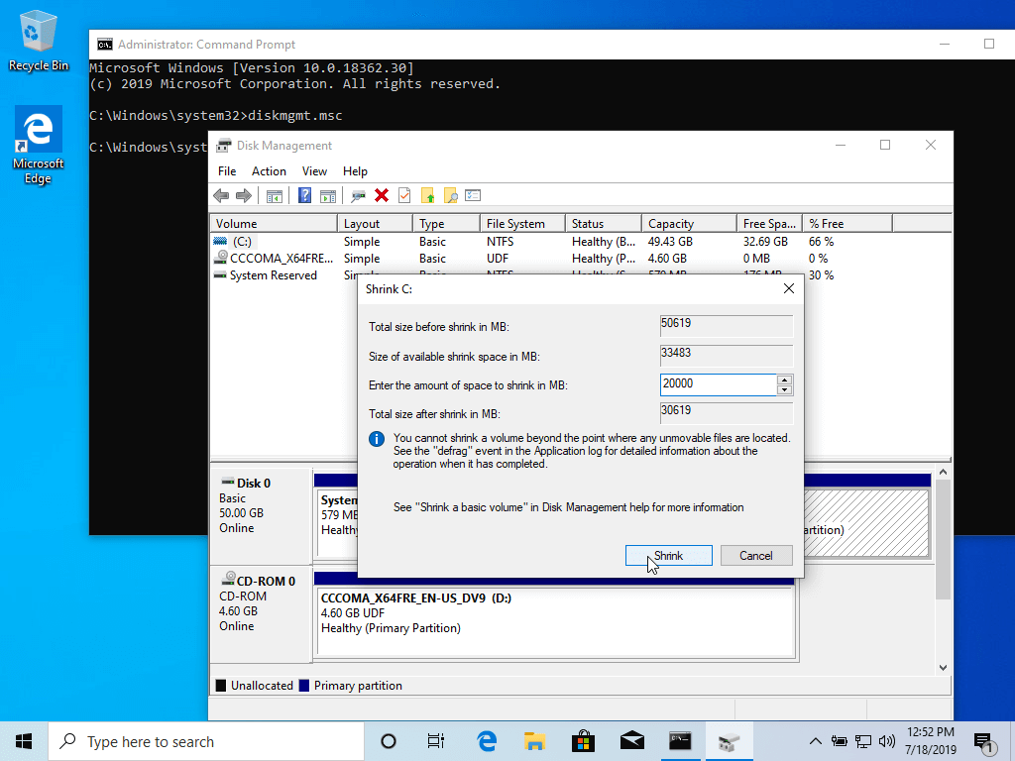
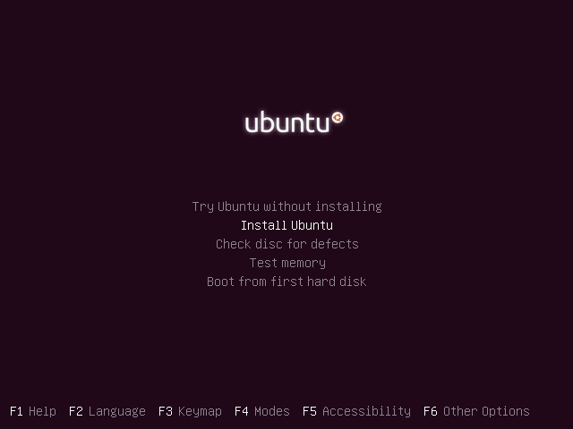
DUAL BOOT TO UBUNTU
1. The first thing you need to take care of is to create free space on the computer hard disk in case the system is installed on a single partition.

Slide 17
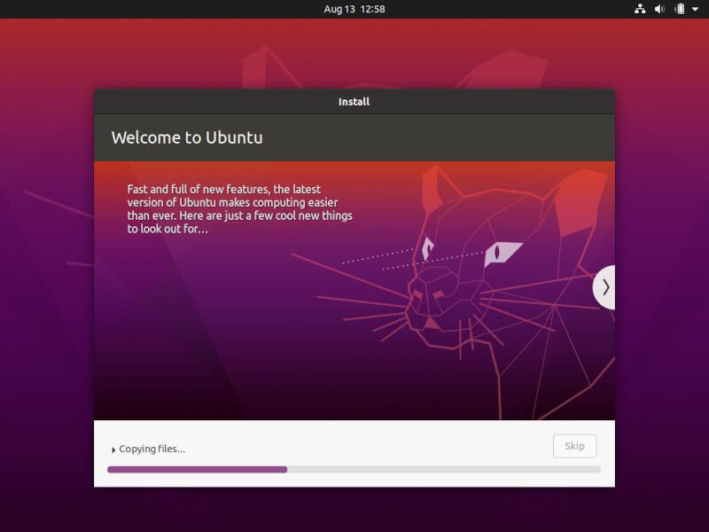
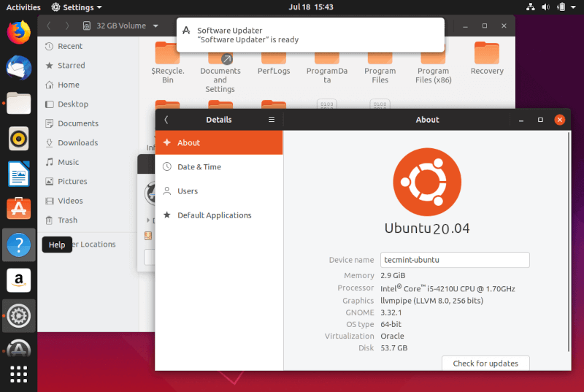

Slide 18
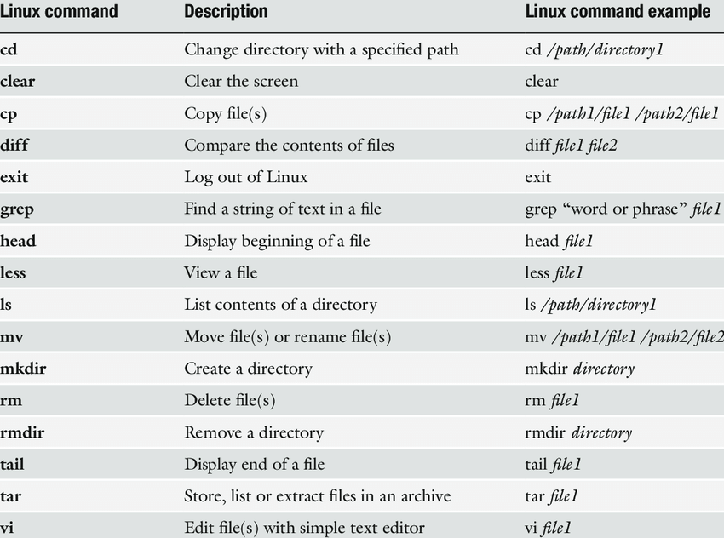
BASIC LINUX COMMANDS

Slide 19
ROS( ROBOT OPERATING SYSTEM)
ROS is an open-source, meta-operating system for your robot. It provides the services you would expect from an operating system, including hardware abstraction, low-level device control, implementation of commonly-used functionality, message-passing between processes, and package management.
ROS allows developers to easily simulate their robot in any environment, before deploying anything in the real world. Tools like Gazebo even allow you to create simulations with robots you don't possess.
LIST OF ros Distributions
ROS NOETIC (RECOMMENDED)
ROS MELODIC
ROS KINETIC
ROS INDIGO

Slide 20
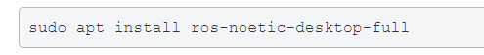
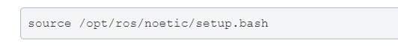
ROS INSTALLATION
Setup your sources.list
Setup your keys
Desktop full install
Environment Setup

Slide 21
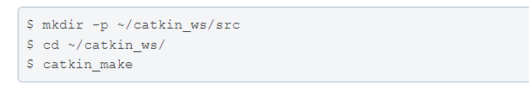
Creating a workspace
A workspace is folder where you modify, build and install packages.
Commands for creating a workspace
ROS PACKAGES : They are the main unit for organizing software in ros.
ROS NODES : They are processes that perform computation.
ROS TOPICS : It is a name that is used to identify content of a message.
ROS SERVICES : They are pair of message structure each for request and reply

Slide 22
MOVEIT
Moveit is a motion planning framework where we can launch our model’s urdf file and simulate it.
PERKS OF INSTALLING MOVEIT IN ROS
It creates collision matrix which detects possibilities of collision
during motion
It helps us to add virtual joints and end effectors in our model.
It helps to plan our robot movement and then execute it in other simulating environments like gazebo.
It creates several configuration files such as launch and controller files.

Slide 23
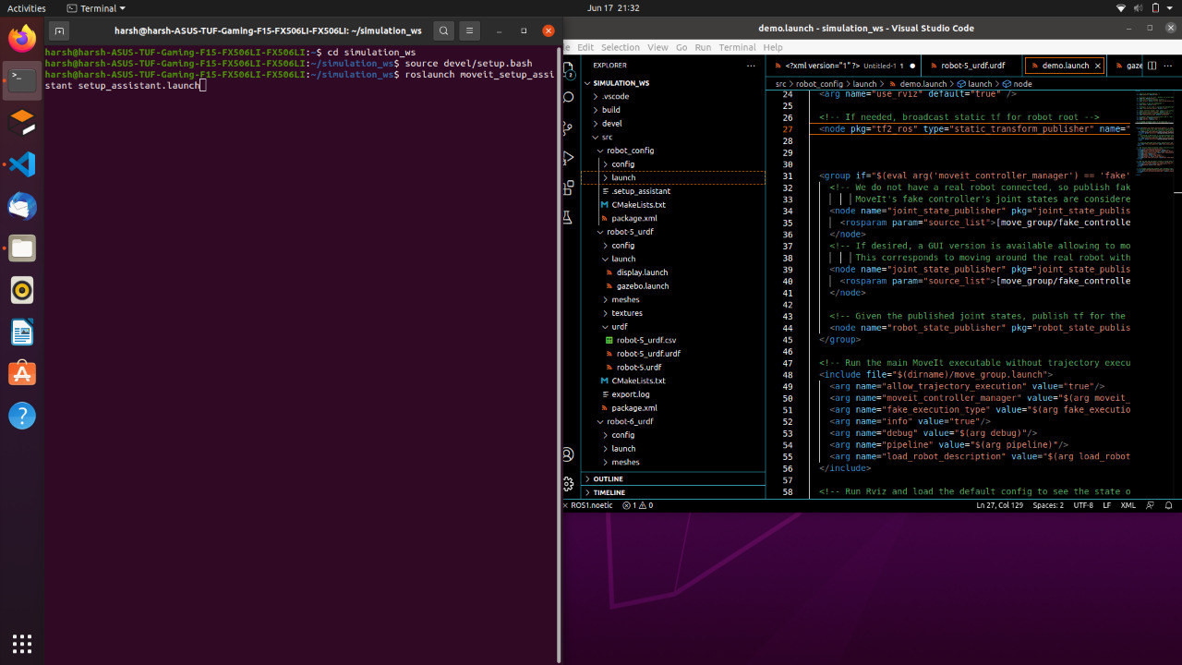
Moveit assistant

Slide 24
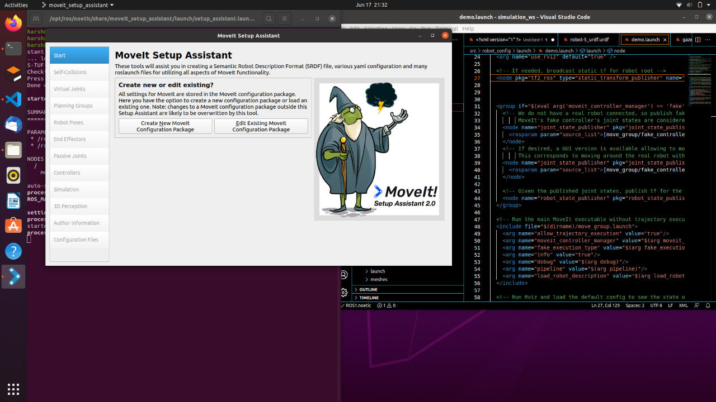

Slide 25
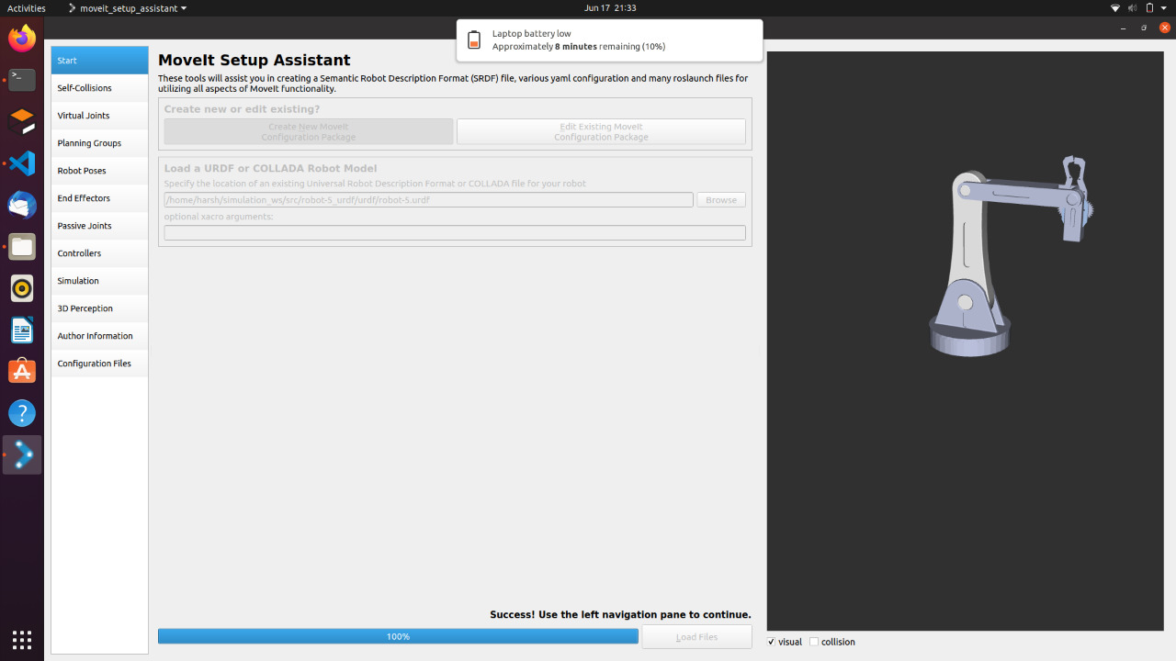

Slide 26
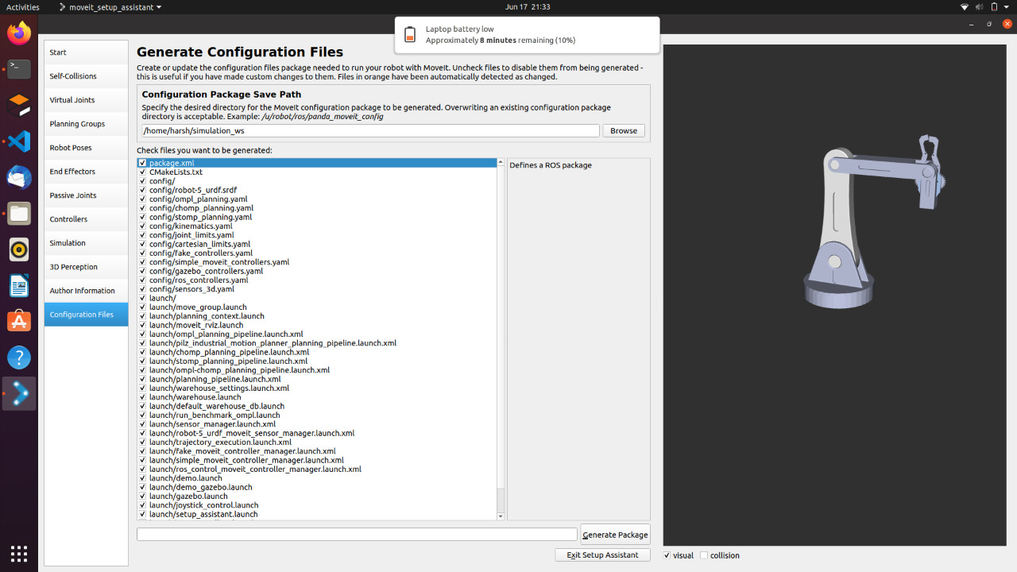

Slide 27
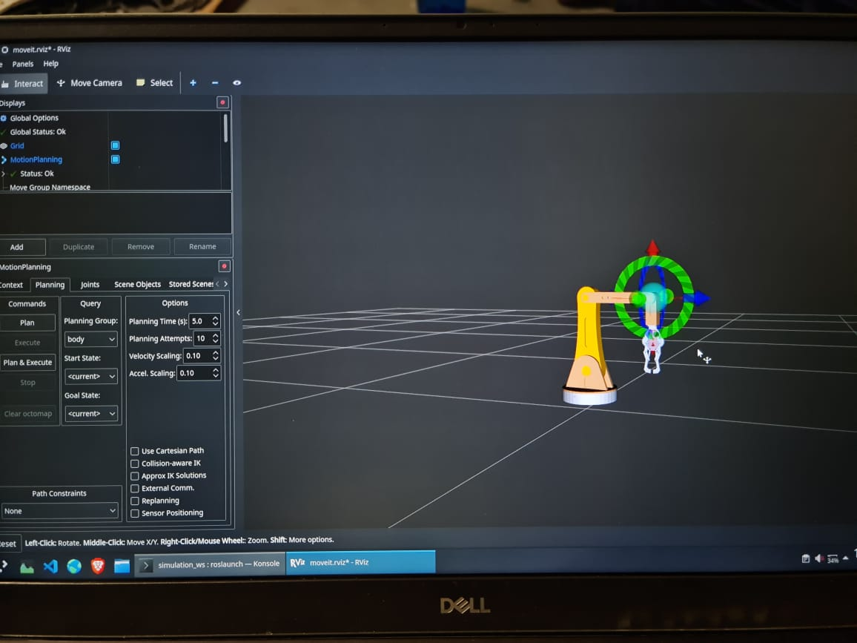

Slide 28
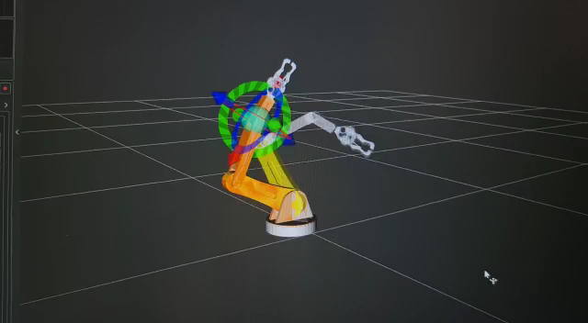

Slide 29


